Slide 1
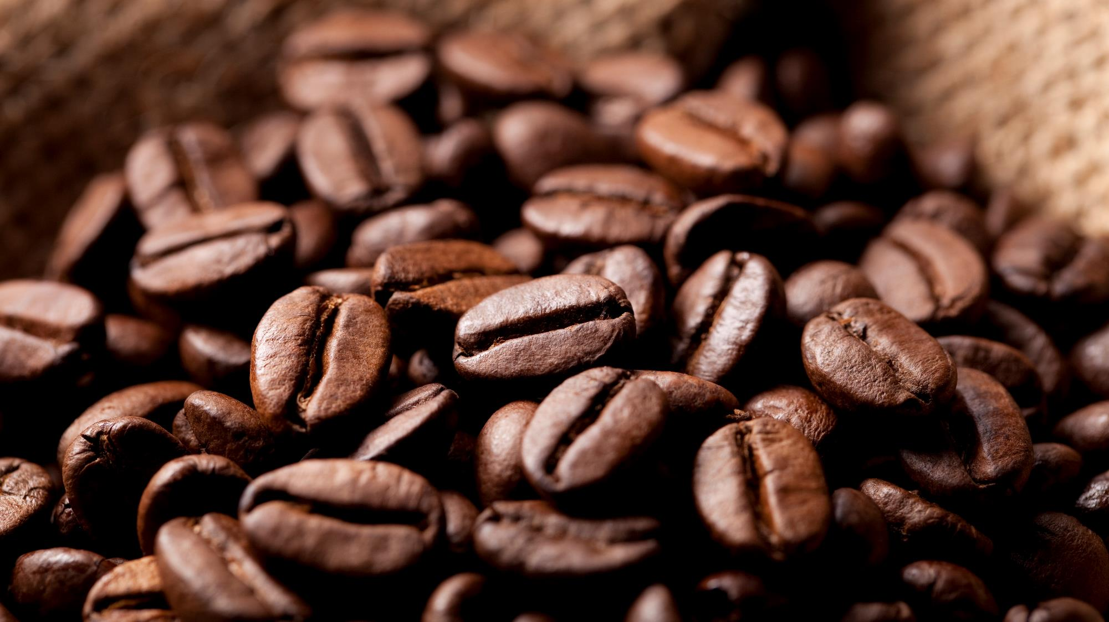
BRIGHT
COFFEE
SHOP
ANALYSIS
JUSTICE MAKETE
BRIGHT LEARN

Slide 2
INTRODUCTION
ABOUT US
ANALYSIS
RECOMMENDATIONS

Slide 3

ABOUT
US
Bright Coffee Shop is a customer-focused coffee business operating across three stores, committed to serving quality coffee, delicious products, and creating a warm experience for our customers.
Our goal is to provide excellent customer service, maintain consistent product quality, and build long lasting relationships with our customers. Through our three stores, we aim to achieve the needs of our customers while growing the Bright Coffee brand and improving business performance.
Our Vision To become a leading coffee shop brand known for quality, customer satisfaction, and sustainable business growth.
Our Mission To deliver excellent coffee, outstanding service, and a consistent customer experience while using data-driven decisions to improve sales and profitability.
- LOWER MANHATTAN
- HELL’S KITCHEN
- ASTORIA

Slide 4
analysis
Bright Coffee Shop generated a total revenue of R698,812.33 across its three stores from January to June, with revenue increasing from R81,677.74 in January to R166,485.88 in June
Best-Performing Store - Hell’s Kitchen generated the highest total revenue of R236,511.17, followed by Astoria at R232,243.91 and Lower Manhattan at R230,057.25
Strongest Sales Period - June recorded the highest monthly revenue at R166,485.88, followed by May at R156,727.76

Slide 5
analysis
Top Revenue (Categories) - Coffee generated the highest revenue of R269,952.45, followed by Tea at R196,405.95 - These two categories contribute the most to total sales across all three stores
Store Performance - Hell’s Kitchen achieved the highest total revenue of R236,511.17, while Lower Manhattan sold the highest number of units at R71,742

Slide 6
analysis
Coffee is the top-performing product category, generating approximately R269,952.45 across the three stores - Tea comes in second, contributing 196,405.95. Together, these categories generate approximately 67% of total revenue.
Hell’s Kitchen leads with R236,511.17 in total revenue, followed by Astoria at R232,243.91 and Lower Manhattan at R230,057.25 - the differences are relatively small, indicating consistent revenue performance across all three stores.

Slide 7
analysis
Barista Espresso generated the highest revenue at R91,406.20, followed by Brewed Chai Tea at R77,081.95 and Hot Chocolate at R72,416.00. These products are important revenue drivers and should always be available in stock.
Coffee products generate the highest category revenue at R269,952.45, while Tea contributes R196,405.95 - indicates strong demand for coffee and tea products across Bright Coffee Shop

Slide 8
analysis
Latte Rg generated R19,112.25, followed by Cappuccino Lg at R17,641.75 and Latte at R17,257.50 – this gives opportunities to grow revenue through effective product placement and targeted promotions
Coffee and Tea remains the strongest categories, generating R269,952.45 and R196,405.95 respectively

Slide 9
analysis
Morning is the Period - Morning sales generated the highest revenue of R388,288.67, representing approximately 55.6% of total revenue - shows that mornings are Bright Coffee Shop’s strongest trading period
Afternoon revenue reached R204,720.83, compared with R105,802.83 in the evening. Coffee was the leading category across all three time periods, generating the highest revenue in the morning at R144,471.80

Slide 10
analysis
TOP 10 PRODUCTS SOLD
Rank | Product | Revenue
1 | Barista Espresso | R91,406.20
2 | Brewed Chai Tea | R77,081.95
3 | Hot Chocolate | R72,416.00
4 | Gourmet Brewed Coffee | R70,034.60
5 | Brewed Black Tea | R47,932.00
6 | Brewed Herbal Tea | R47,539.50
7 | Premium Brewed Coffee | R38,781.15
8 | Organic Brewed Coffee | R37,746.50
9 | Scone | R36,866.12
10 | Drip Coffee | R31,984.00

Slide 11
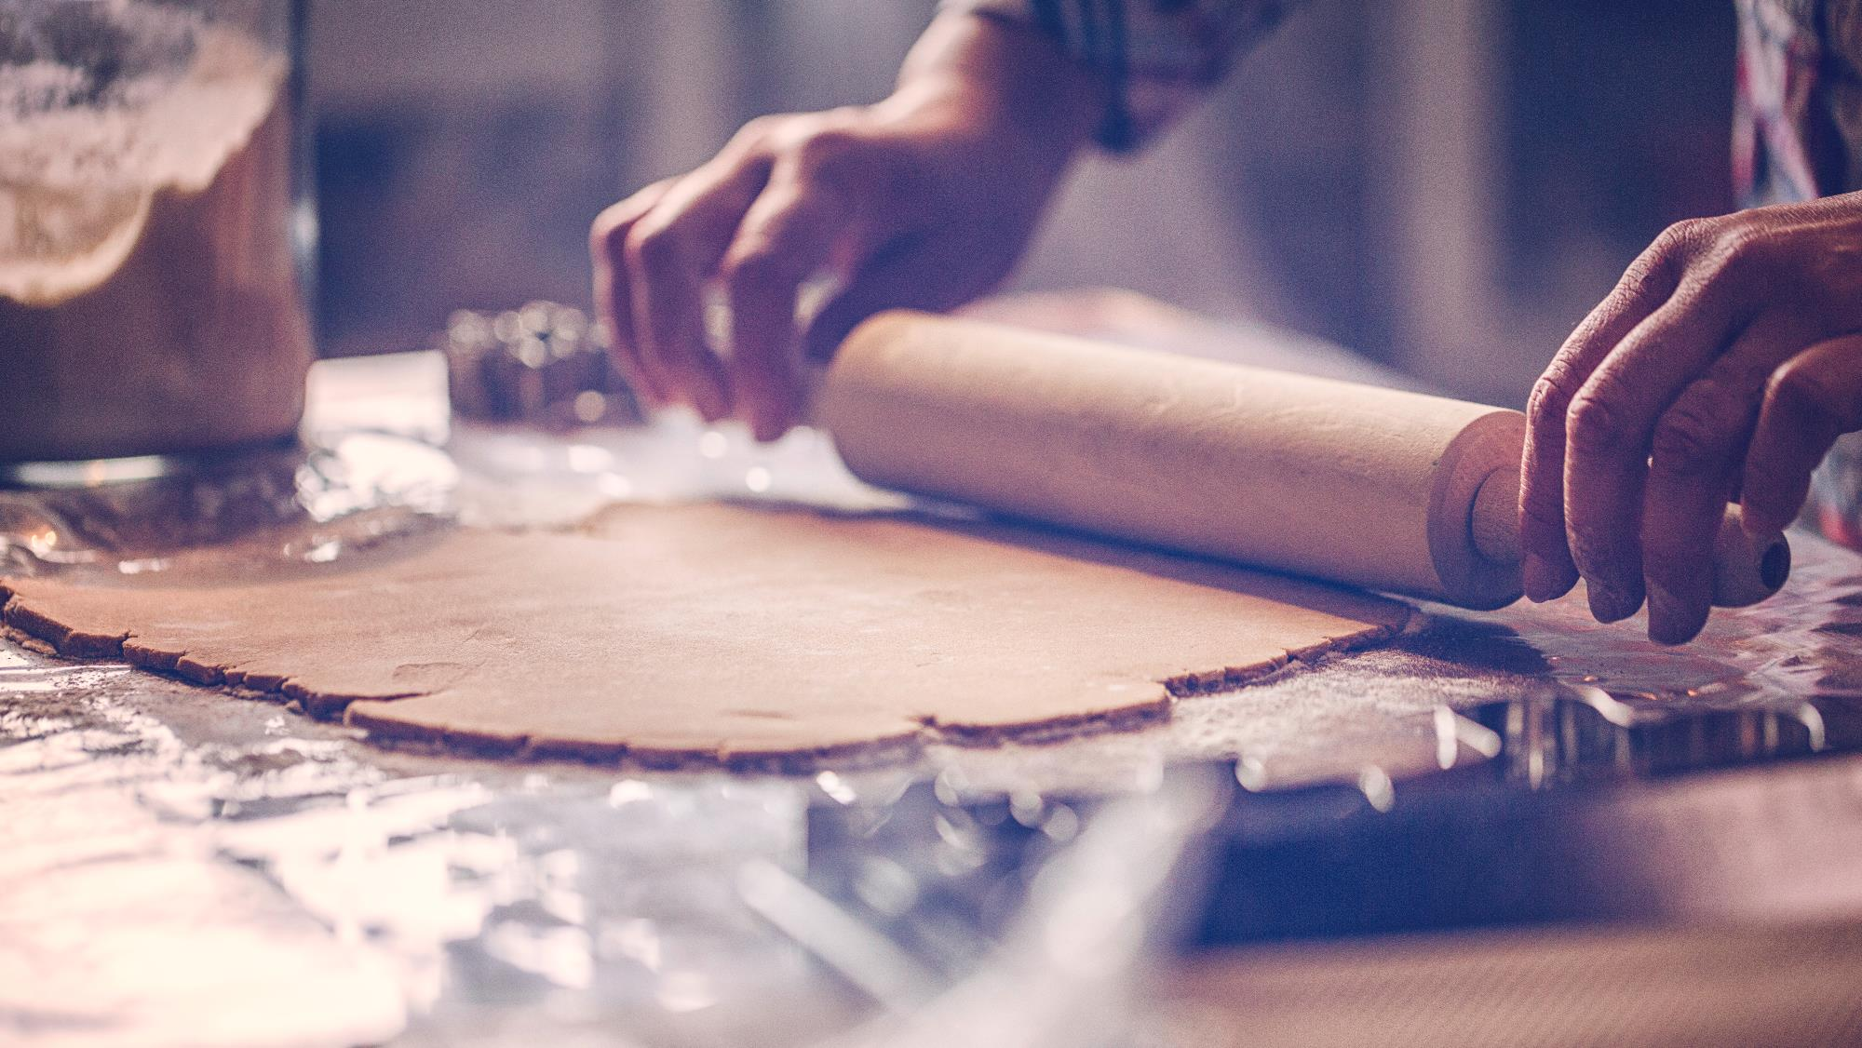
Introduce targeted afternoon promotions, such as coffee-and-snack deals, and evening specials to encourage additional visits.
Ensure sufficient staff, coffee supplies, and bakery stock during morning peak hours.
Use Hell’s Kitchen as a benchmark to identify successful sales practices and apply them at Astoria and Lower Manhattan
Do a deep dive into the strong sales in May and June, including customer demand, promotions, and product performance.
Review customer demand, product pricing, and targeted promotions to improve sales performance in the lowest performing categories such as Packaged Chocolate & Flavours.
Use complementary or More-4-Less offers, such as coffee with pastries, to increase average customer spending.
Review sales, pricing, and customer demand for lower-revenue articles as Organic Chocolate, Green Beans, and Green Tea – have promotions before deciding whether to adjust stock holding or product selection.
RECOMMENDATIONS

Slide 12
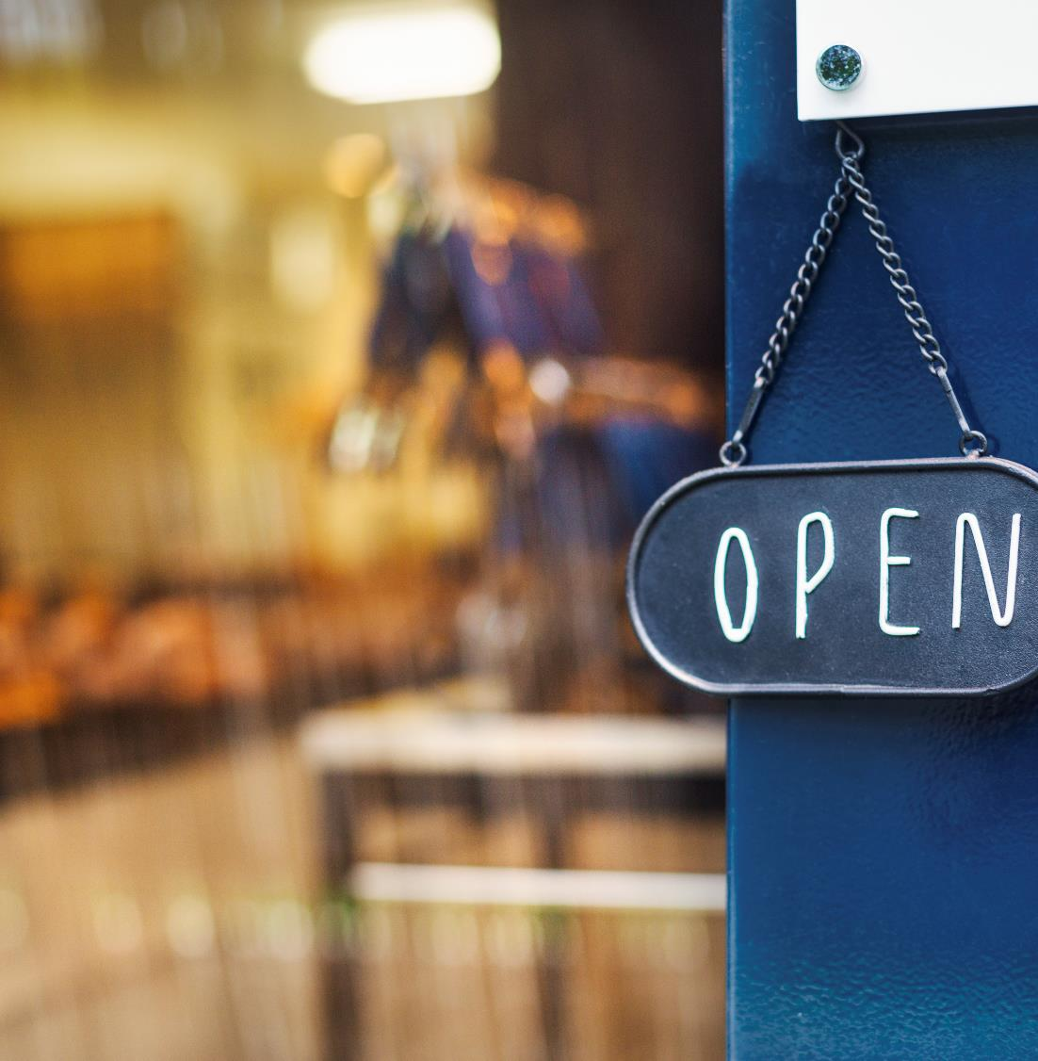

Thank You
Email
mmjthegod@gmail.com

